Slide 1
Automatic Generation of Bibliographic Records for Korean DVDs
Committee on Technical Processing:
Providing Quality Metadata for Diverse Collections
March 22, 2018
Hyoungbae Lee
Korean Studies Librarian
Princeton University Library

Slide 2
Growth of Korean DVD Collection
From 3 (6/30/2007) to 1,770 titles (6/30/2017)¹
  1 faculty member (tenured) since 2007
  Hub Library for Korean Film Studies by KOFIC (2009-2010)
  Film studies as one of Princeton’s specialized subjects in KCCNA (2012-present)

Slide 3
Backlog Problem
Acquisition/cataloging statistics of Korean films
Year | Purchase | Processed | Backlog
Until 2013 |  |  | 610
2014 | 147 | 162 | -15
2015 | 249 | 206 | +43
2016 | 109 | 96 | +13
2017 | 173 | 214 | -41
TOTAL | 678 | 678 | 610

Slide 4
DVD Metadata: Long
BOOKS
DVDS
Authors, editors, etc.
Pages, dimensions
Directors, actors, film editors, film producers, screenwriters, composers, etc.
Duration, dimensions, video/sound/digital file characteristics, etc.
Aspect ratio, audience note, summary, etc.

Slide 5
DVD Metadata: Regular
BOOKS
DVDS
Author
  著者, 글쓴이, 著, 編著, 씀, 지음, 지은이, ∅, etc.
Editor
  編輯, 編者, 編, 監修, etc.
Director
  監督
Film editor
  編輯

Slide 6
DVD Metadata: Interrelated
Running Time (100 min.)
  Time: 100
  300: ǂa 1 videodisc (100 min.)
  306: ǂa 01400
Dolby Digital 5.1
  007: ǂi q
  344: ǂg surround ǂh Dolby Digital 5.1

Slide 7
Collecting Information

Slide 8
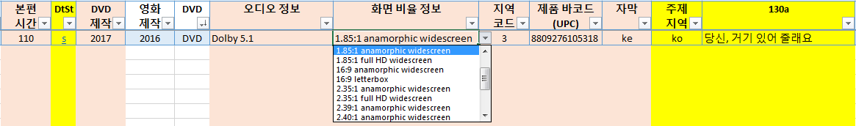
Metadata Template
  Yellow: supplied automatically or by me.
  Pink: information about the DVD
  No color: information about the film
  Technical specification: select from drop-down menu

Slide 9

Automation Tool: AutoIt

Slide 10
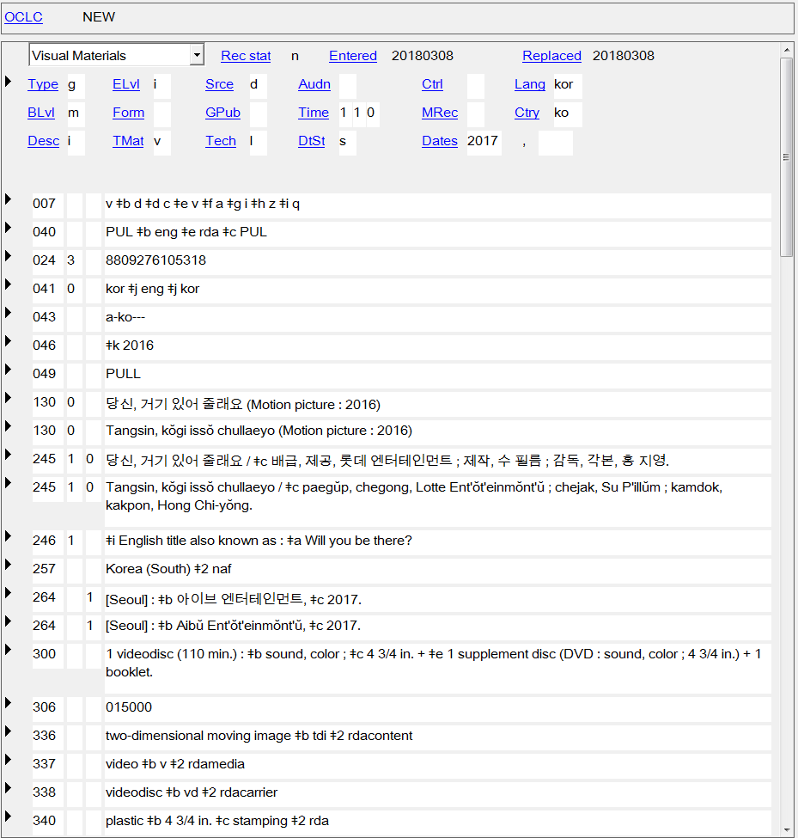
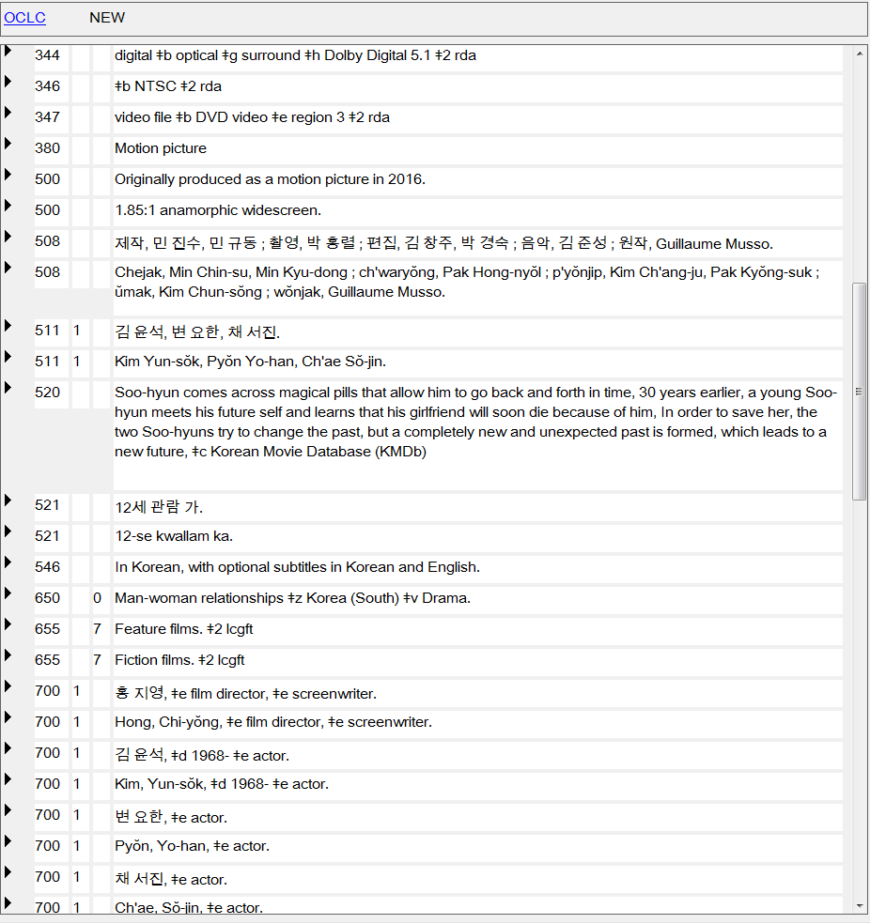
Table to Bib Record

Slide 11
Touch-Up for Upload
Check romanization
Check name authority records
Enter or modify subject headings
Overall proofreading

Slide 12
